Slide 1
Model Blimp Design Competition Soldering Workshop by Youth College (International) / VTC 09:30 – 11:00 11:00 – 12:30
---11 May 2019---

Slide 2
Lecturer
Edmond Leung
Senior Lecturer
Youth College (International)
Vocational Training Council (VTC)
Email : whleung@vtc.edu.hk

Slide 3
Wifi and file download
Wifi SSID:
YCI_2_4G / YCI_5G
Or
YCI_2_4G_2 / YCI_5G_2
Password:
ycinternational
PowerPoint and material download
//172.19.124.20
User : airship
Password : ycinternational

Slide 4
Content
System design of Airship control
Soldering practice on Multi-purpose PCB
Soldering of Arduino D1 min and Driver

Slide 5
System design of Airship control
Requirements
Fly in the air
Motion in the air
Forward, Backward, turn right, turn left, rise and decline
Wirelessly control with around
Rise
Airship
Forward
Backward
decline
Turn Left/Right

Slide 6
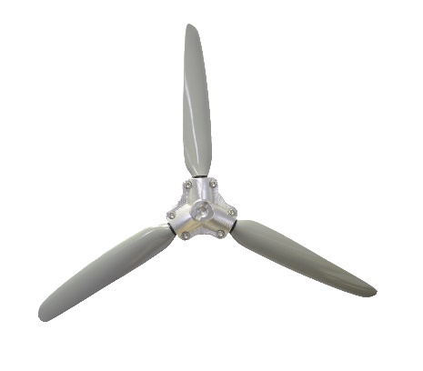
System design of Airship control
Rise
decline
Front View
Top View
At least three motors are needed

Slide 7
Reference Design

Slide 8
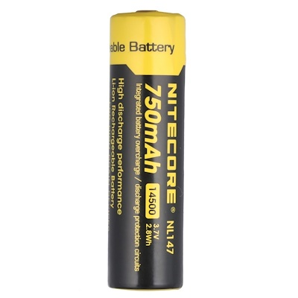
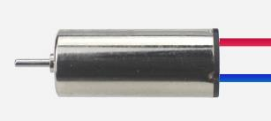
Overall system design
PWM
PWM
Serial (programming & debug)

Slide 9
Schematic Diagram
Signal Wire connection
D1 mini | D8 | IN1 | Motor Drive1
 | D7 | IN2
 | D6 | IN3
 | D5 | IN4
 | D1 | IN2 | Motor Driver2
 | D2 | In2

Slide 10
2. Soldering practice on Multi-purpose PCB

Slide 11
Prepare Solder Iron
Turn on the solder Iron and adjust it to around 270°C

Slide 12
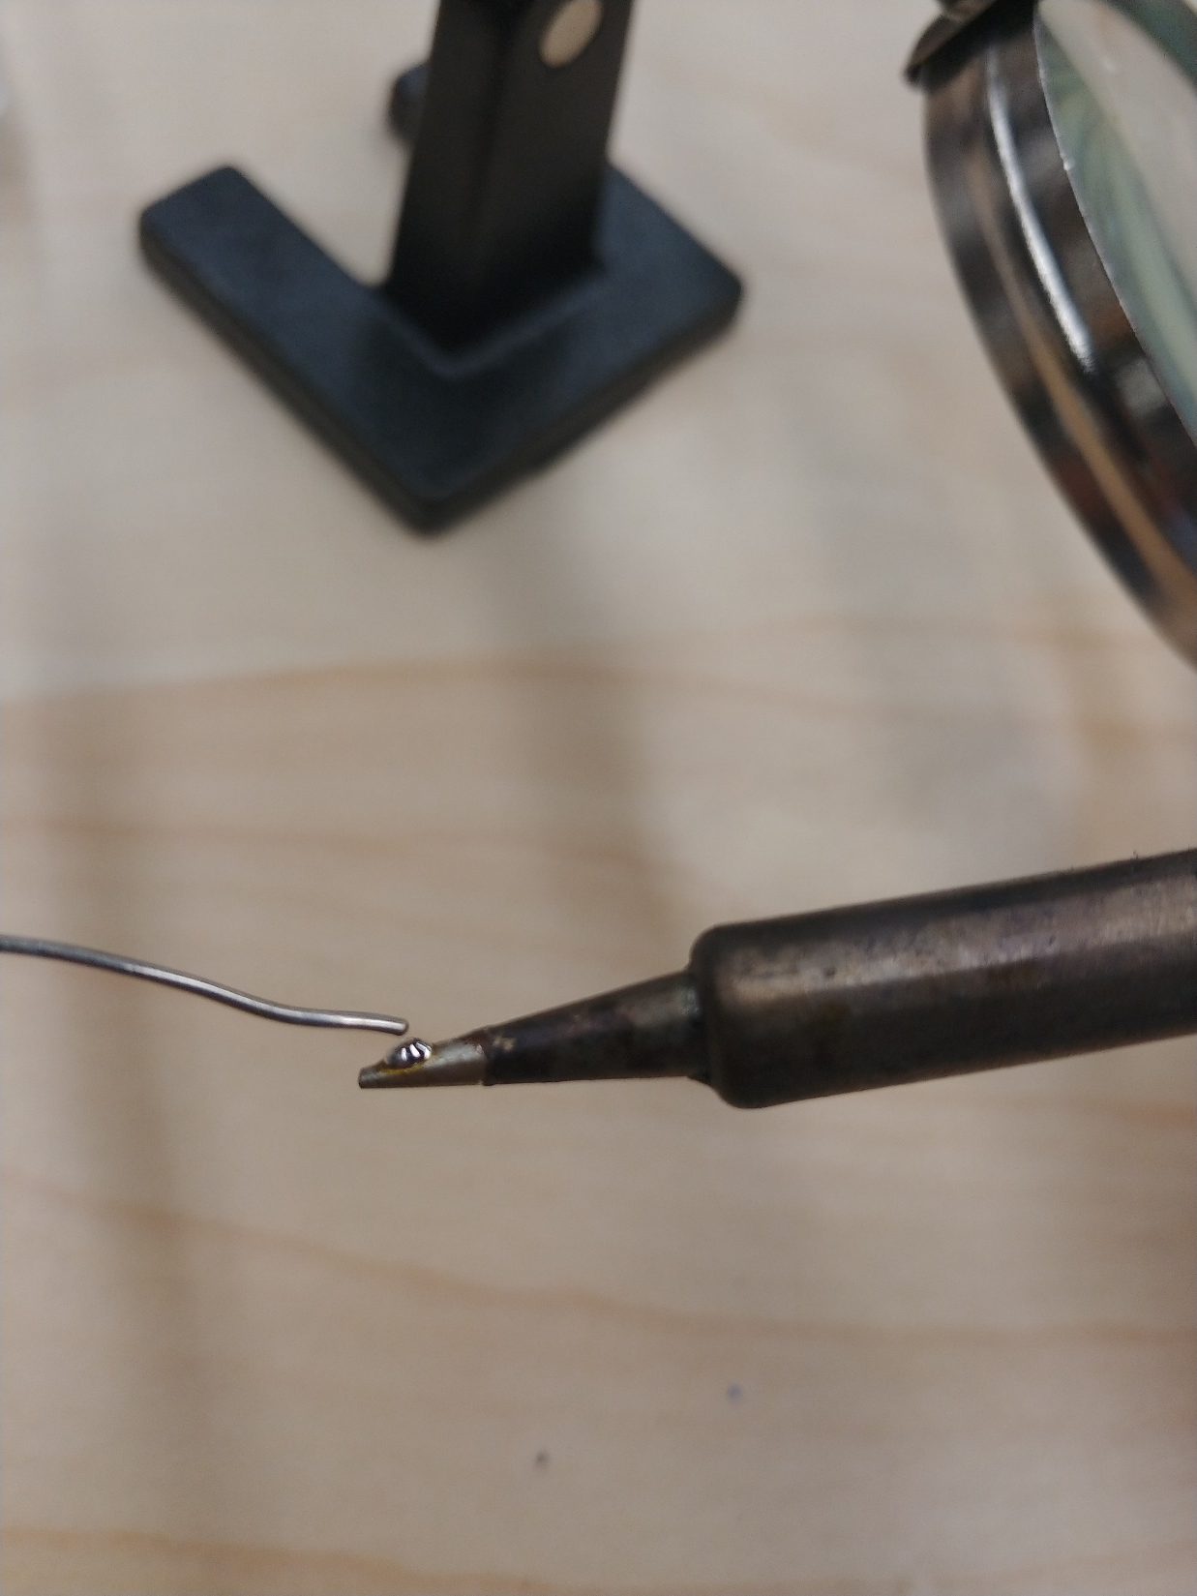
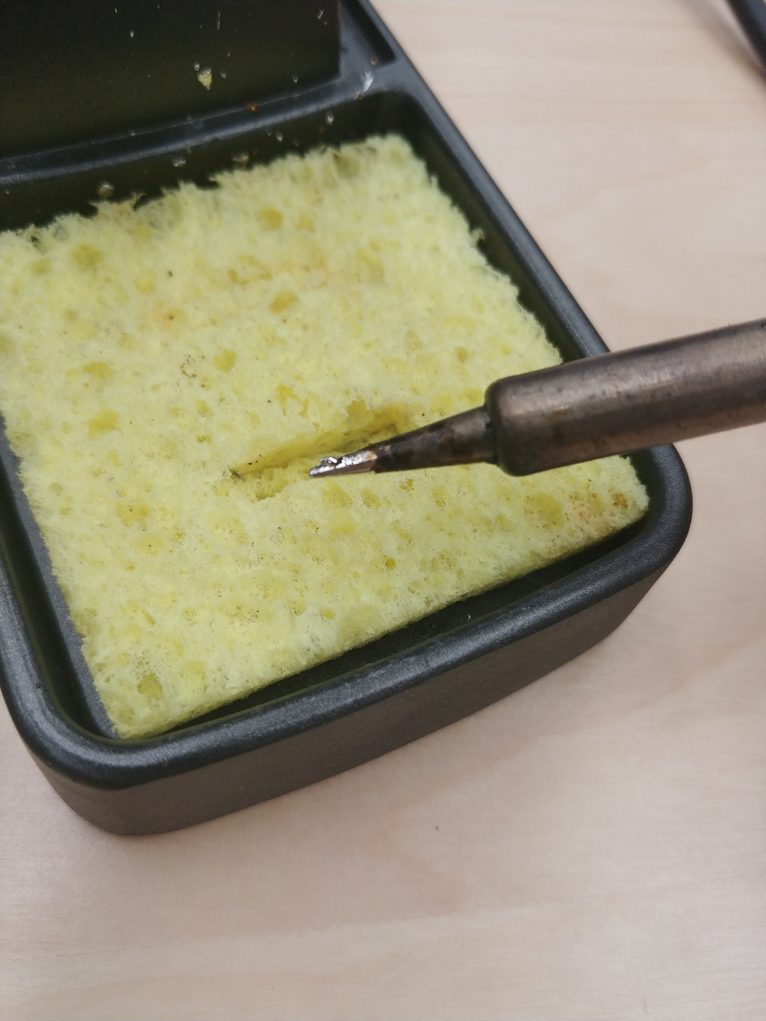
Prepare Solder Iron
Clean the solder iron on sponge

Slide 13
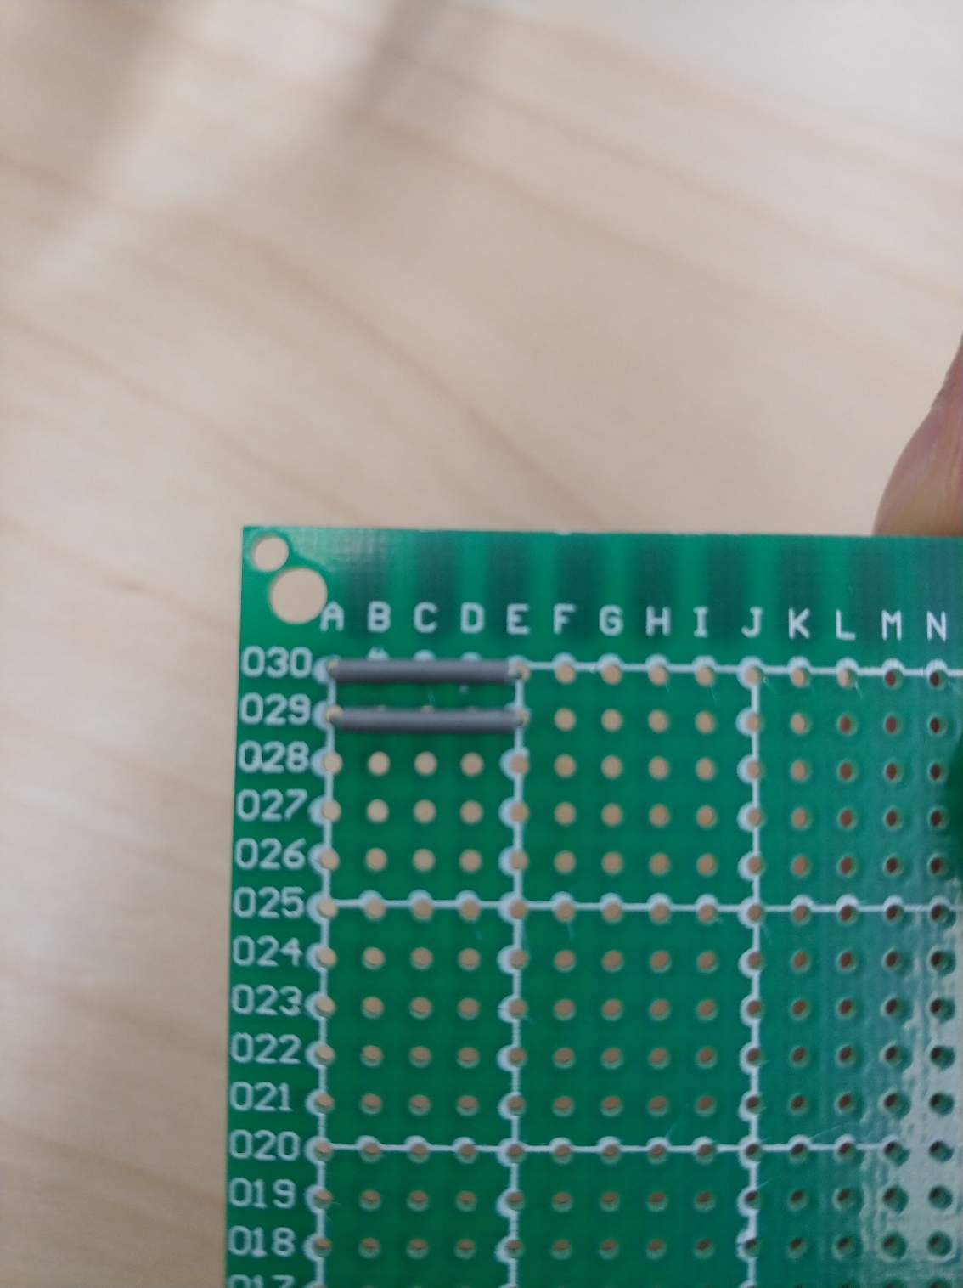
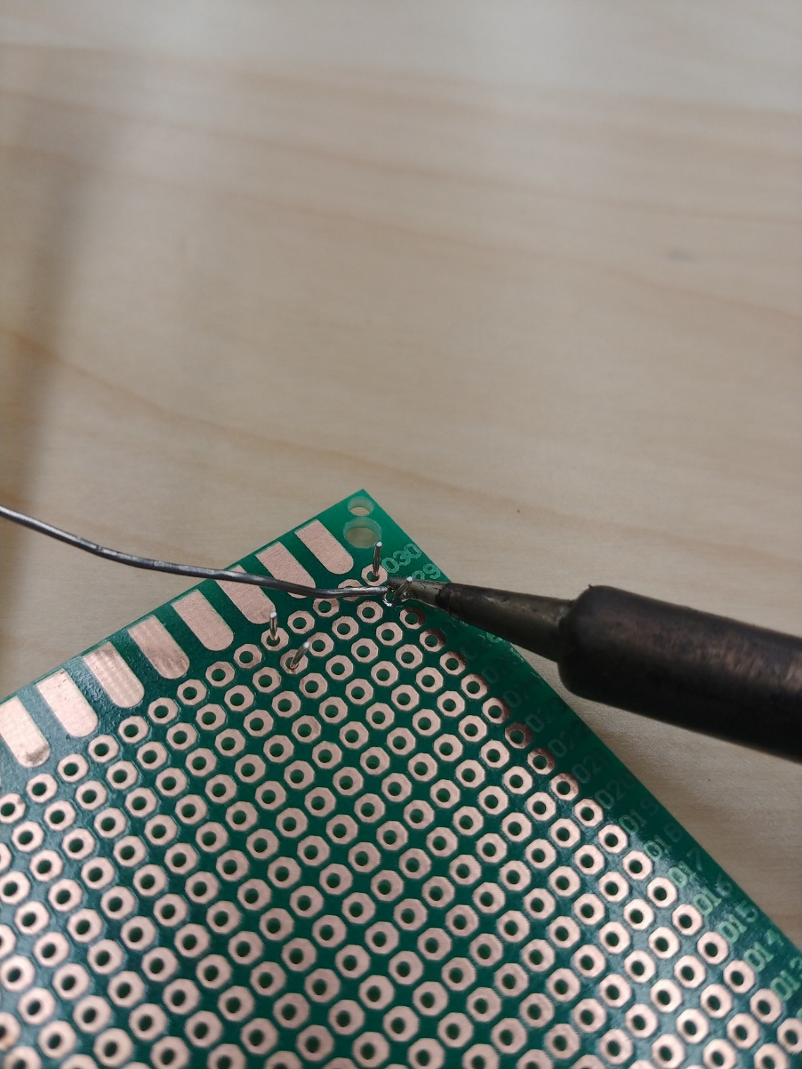
Soldering practice – Try to solder two wires on a multipurpose PCB
Try to use the solder iron to heat-up the point you want to solder
Using the heated point to melt the solder wire

Slide 14
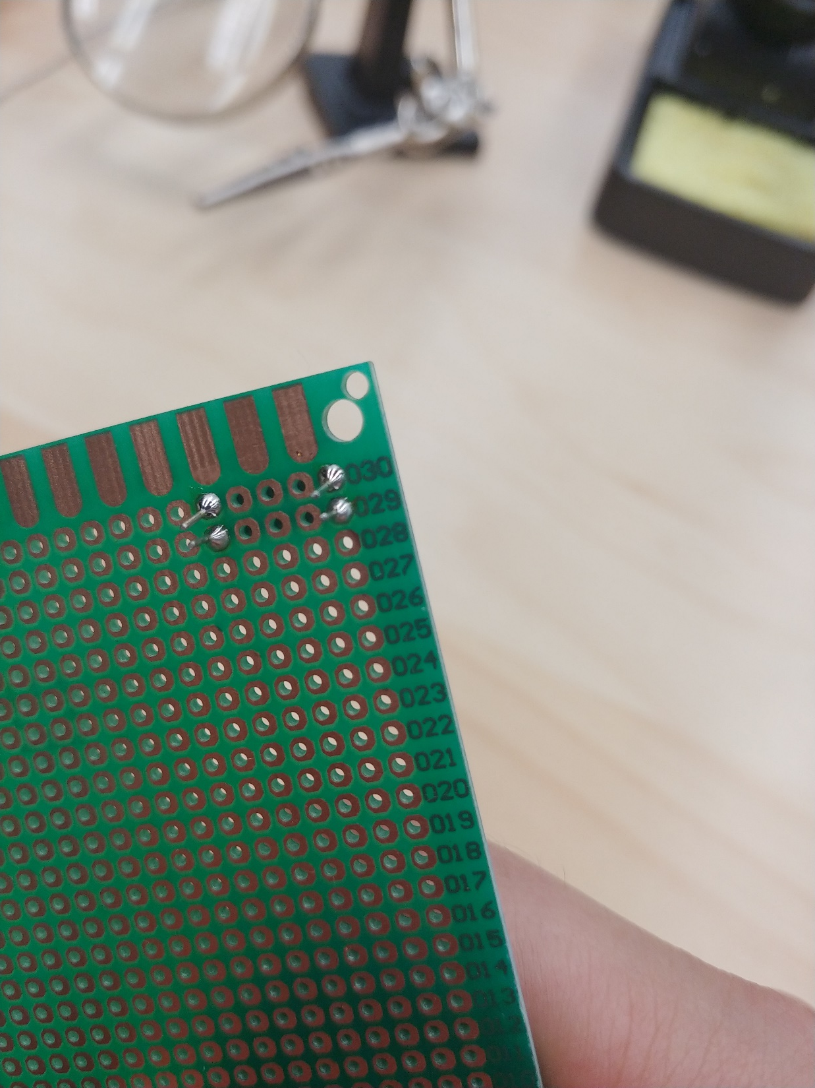
Soldering practice – Try to solder two wires on a multipurpose PCB
The entire hole should be covered by melted solder wire
The melted solder wire should be Shine and clean
Cut the extra wire after soldering

Slide 15
2. Soldering of Arduino D1 min and Driver

Slide 16
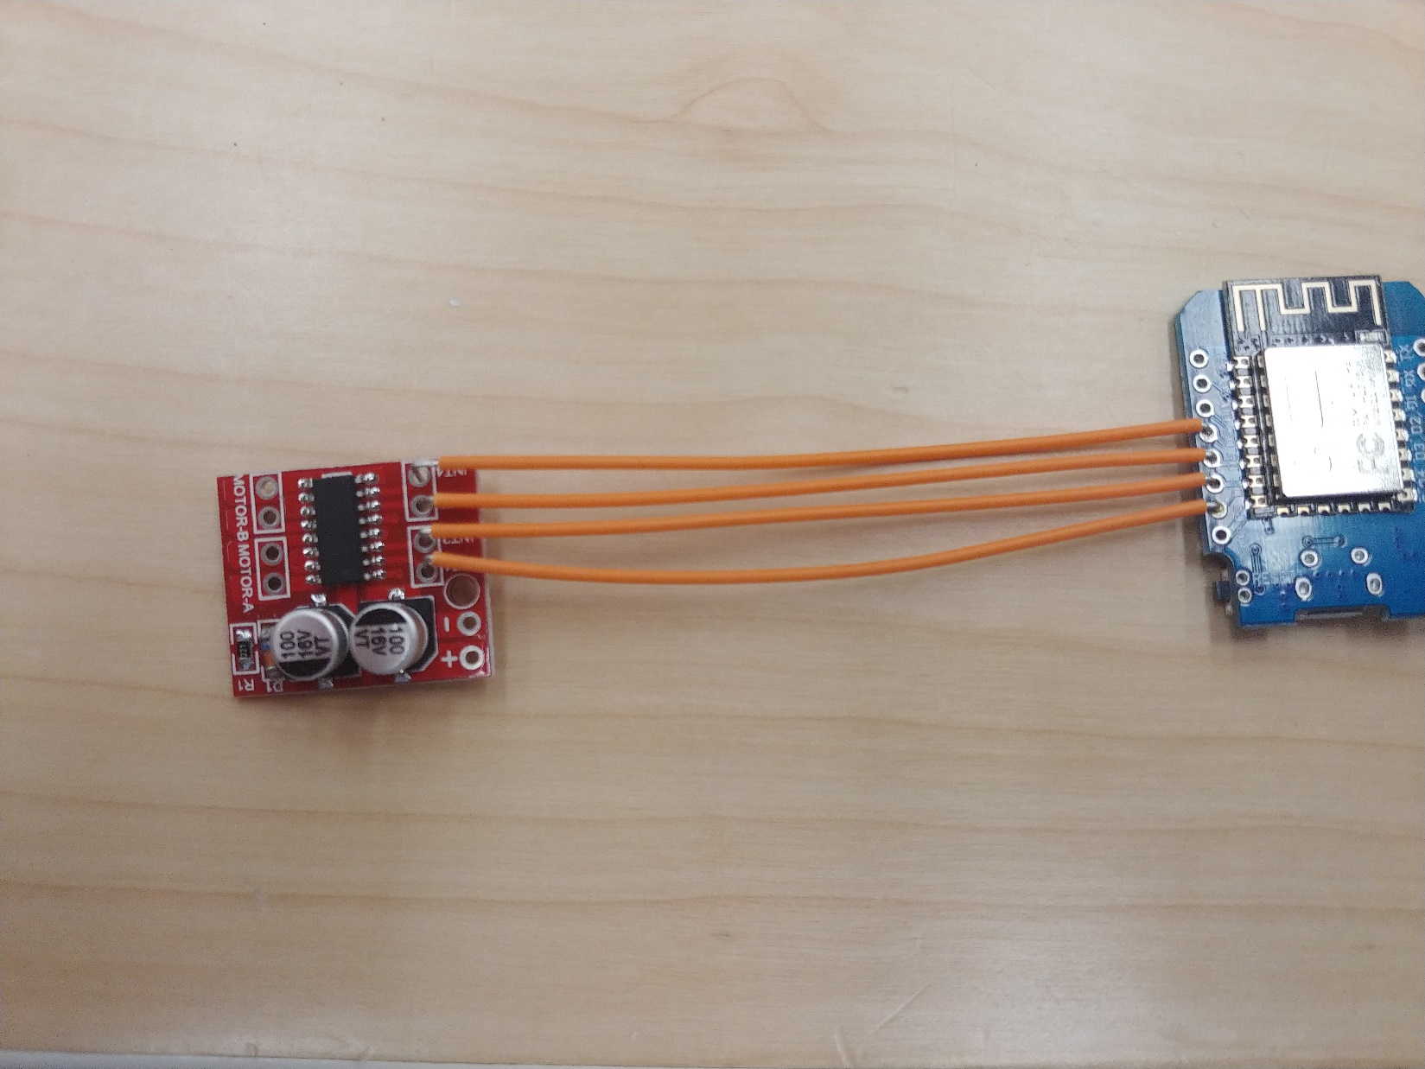
1. Signal wire from D1 mini to Driver1
D1 mini | D8 | IN1(A1) | Motor Drive1
 | D7 | IN2(A2)
 | D6 | IN3(B1)
 | D5 | IN4(B2)
 | D1 | IN2 | Motor Driver2
 | D2 | In2

Slide 17
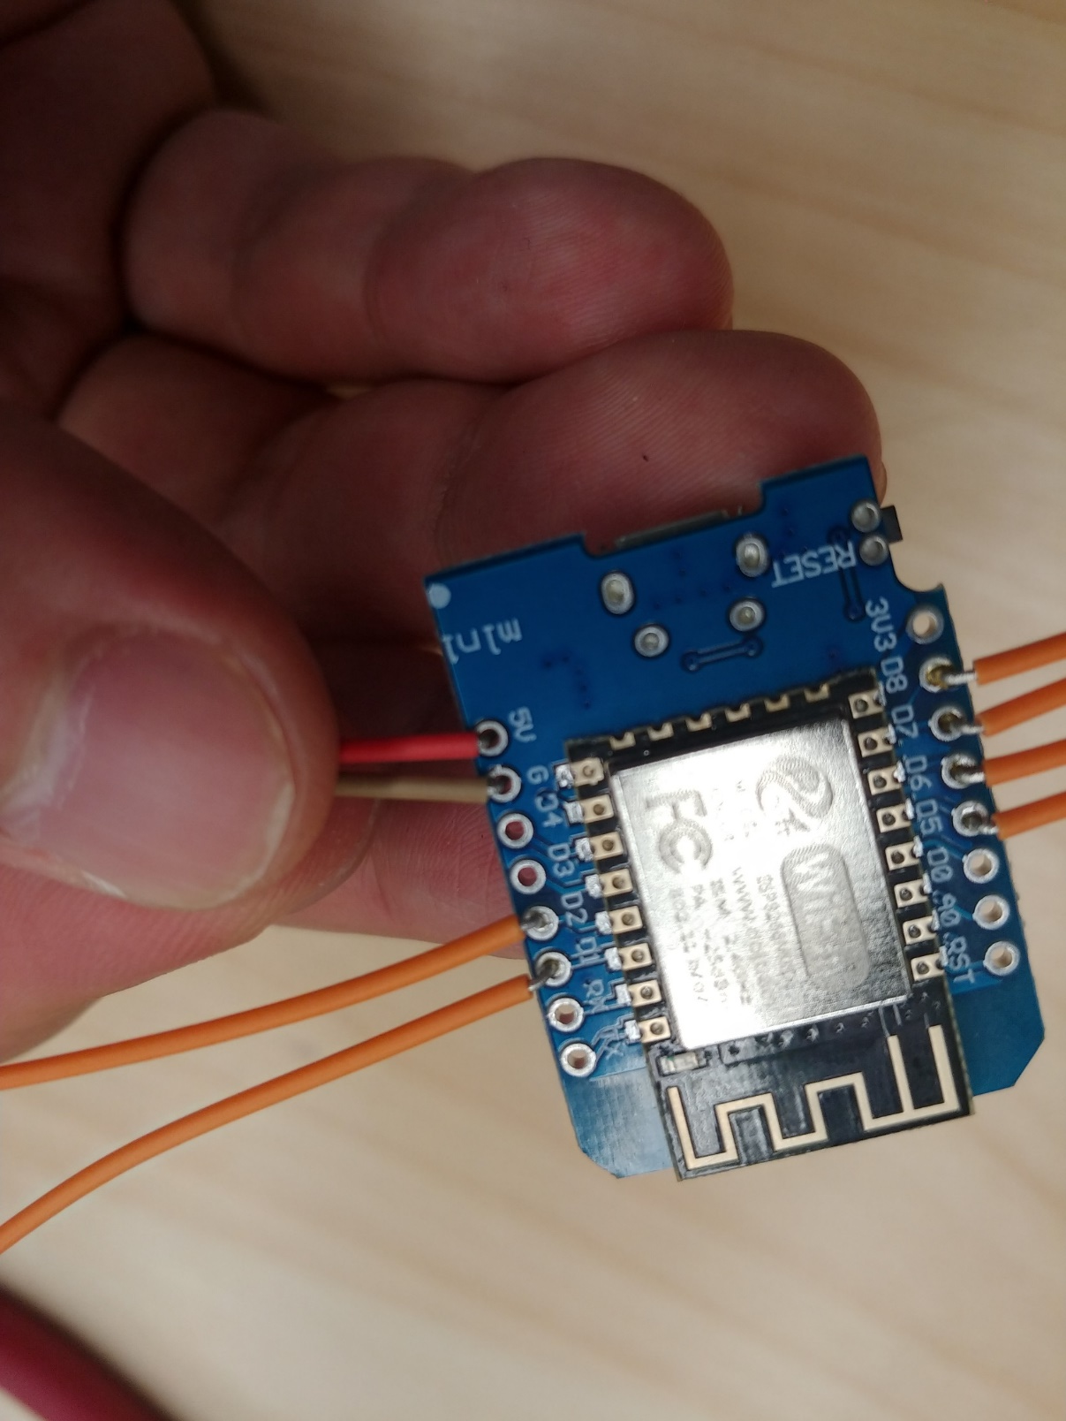
2. Signal wire from D1 mini to Driver1
D1 mini | D8 | IN1 | Motor Drive1
 | D7 | IN2
 | D6 | IN3
 | D5 | IN4
 | D1 | IN1 (A1) | Motor Driver2
 | D2 | In2 (A2)

Slide 18
3. Supply wire between Battery and controller
Using Light/Red color wire as +

Slide 19
3. Supply wire between Battery and controller
Add a Voltage meter
Group all the + and – together with a heat shrink tube
Using light color as +
Using dark color as -

Slide 20
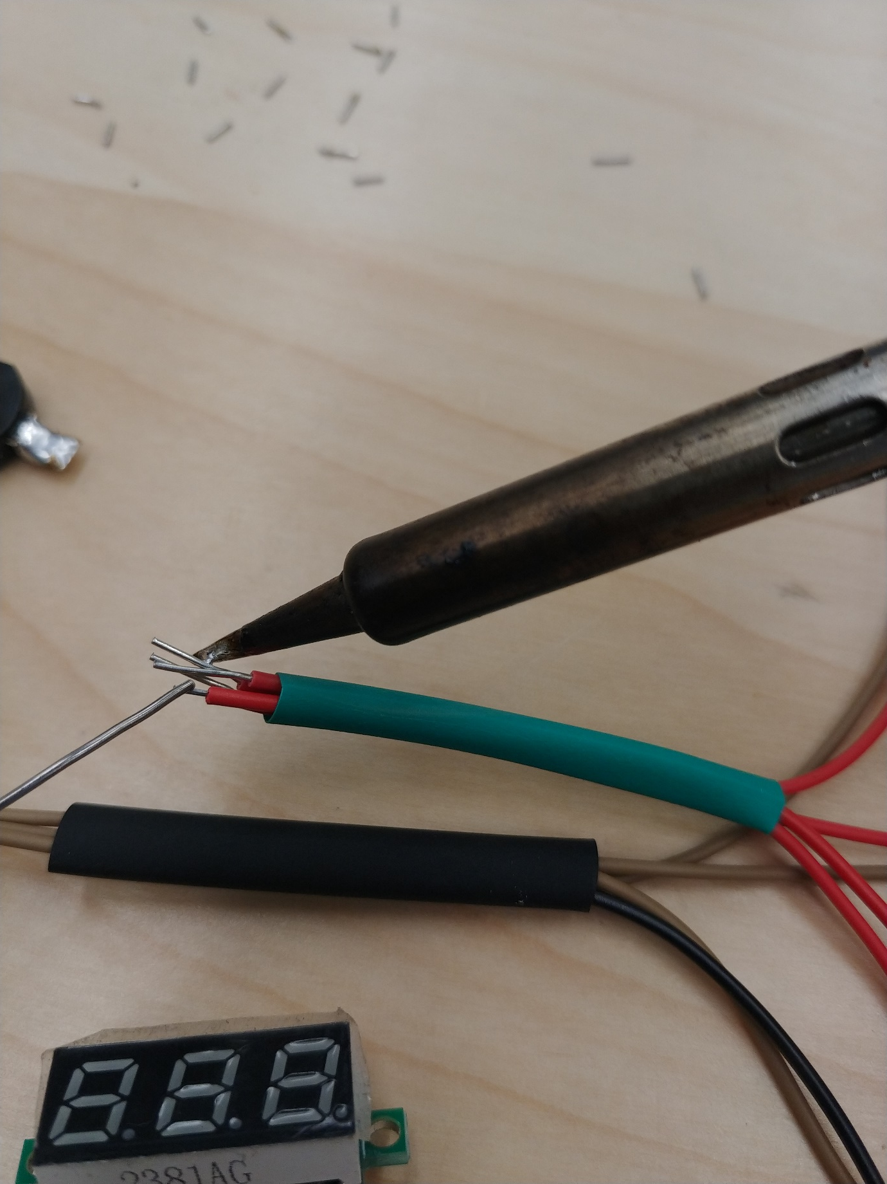
3. Supply wire between Battery and controller
Solder the wires
heat shrink tube is too close to the soldering point

Slide 21
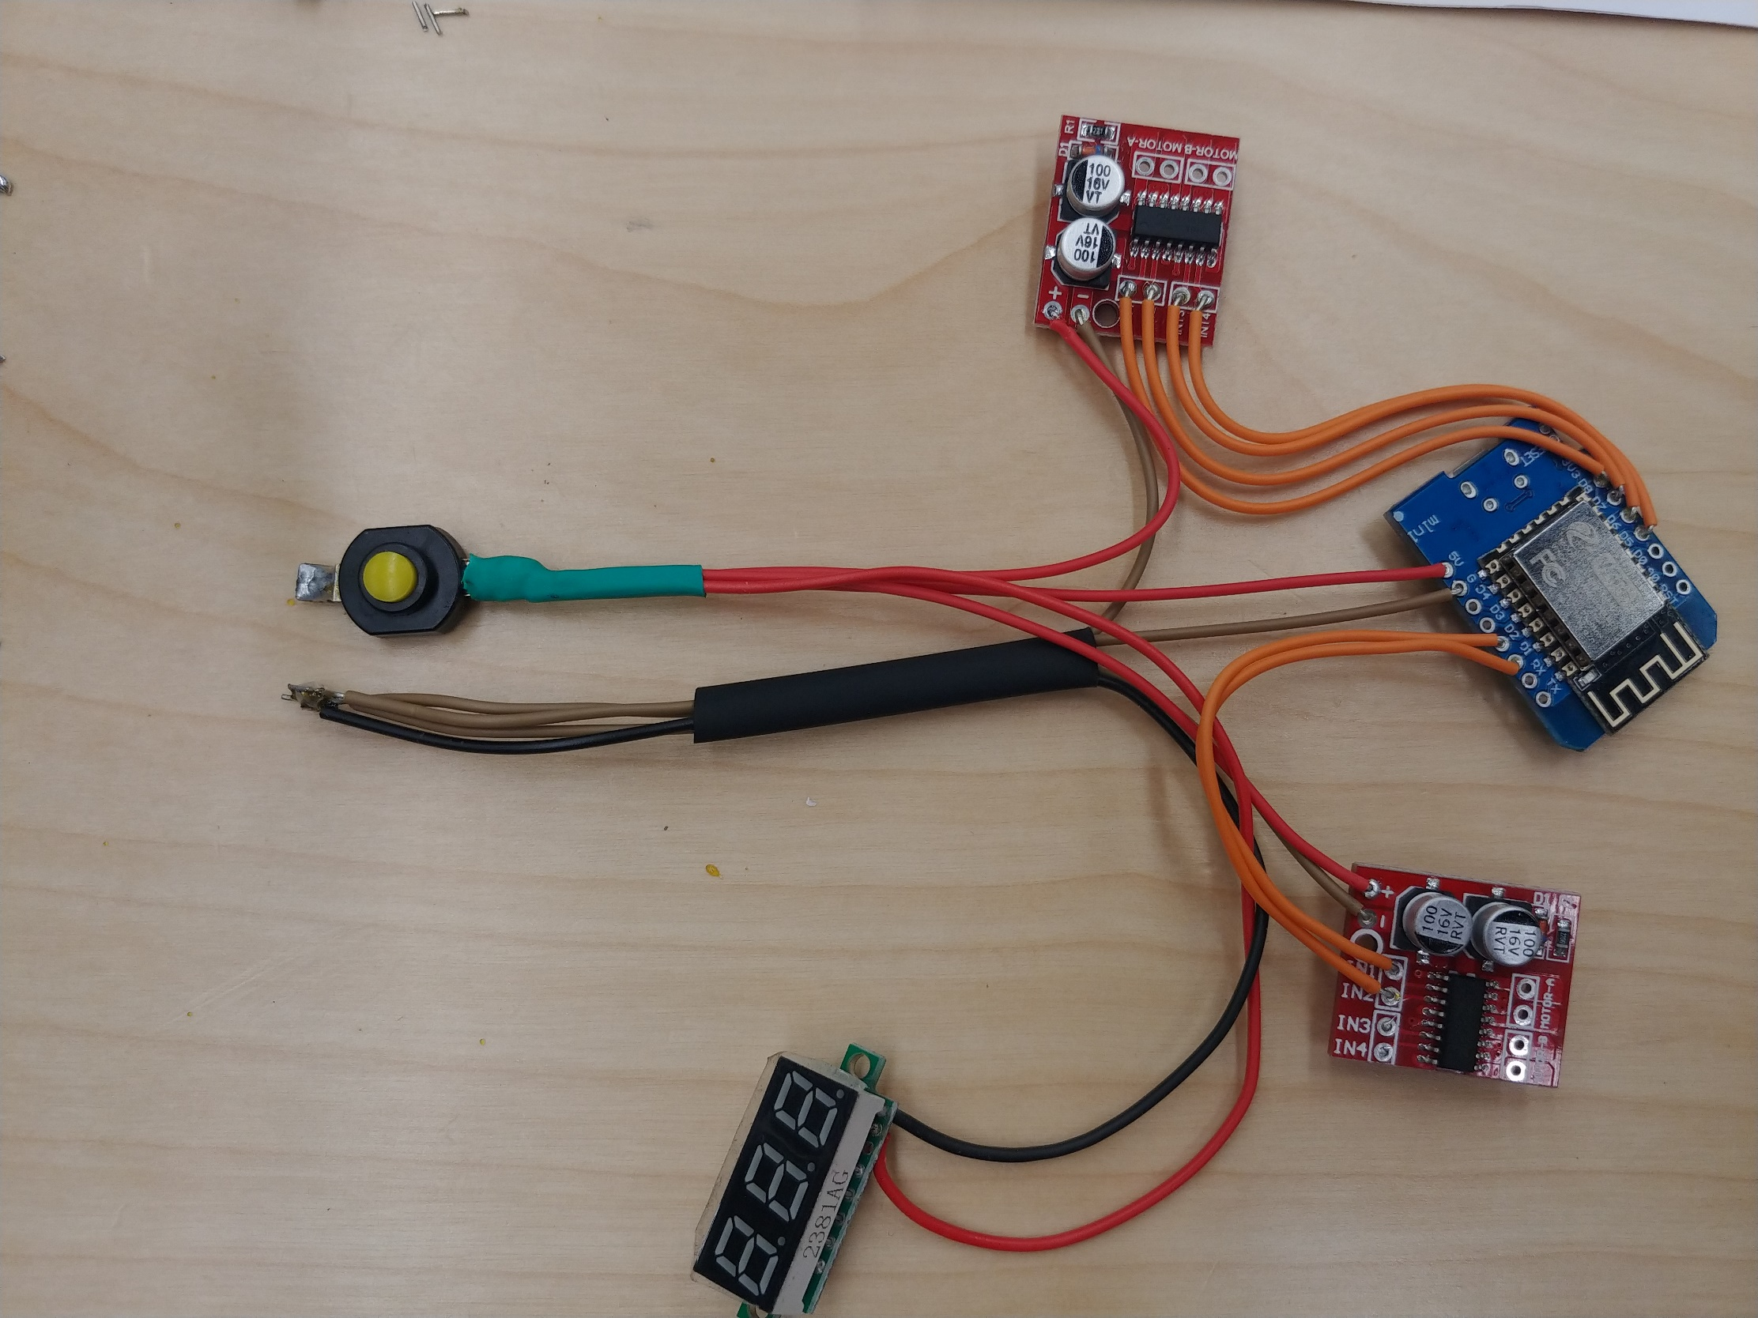
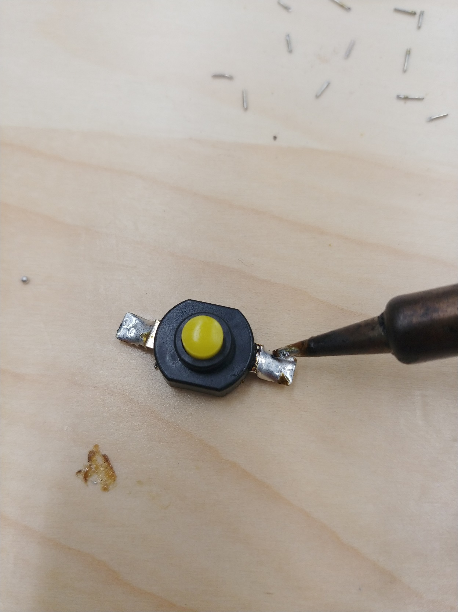
3. Supply wire between Battery and controller
Add a switch

Slide 22
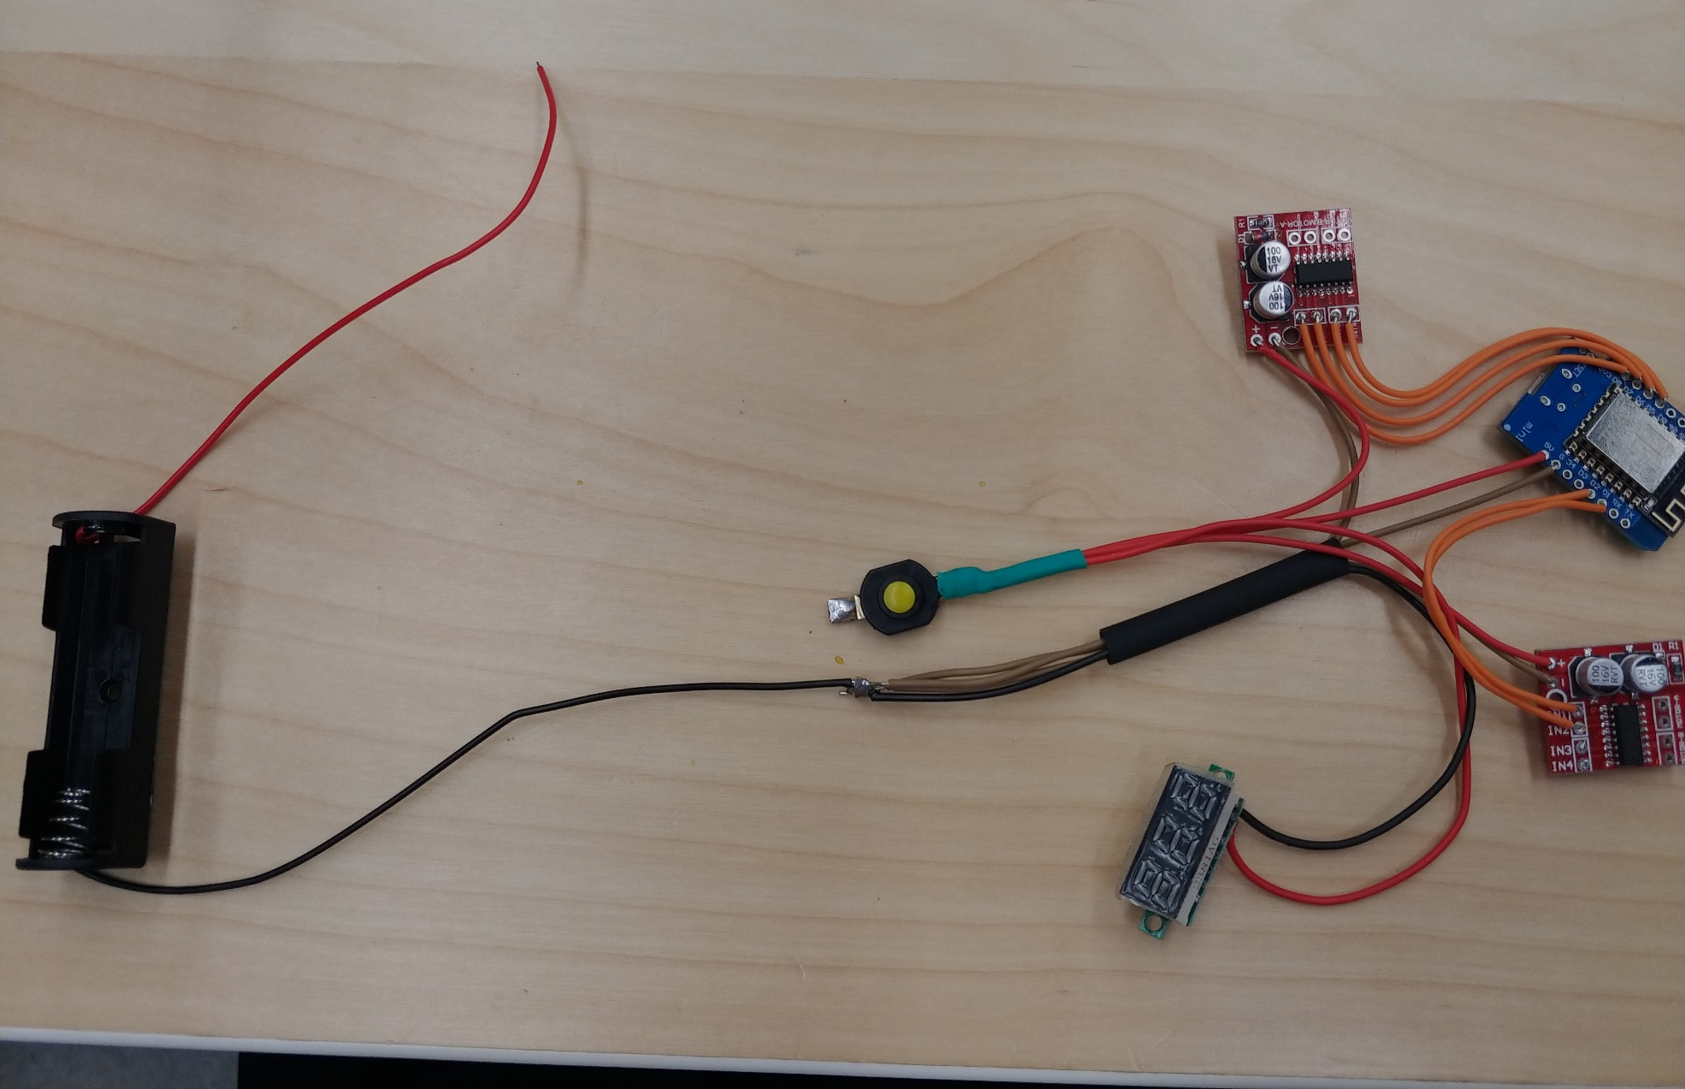
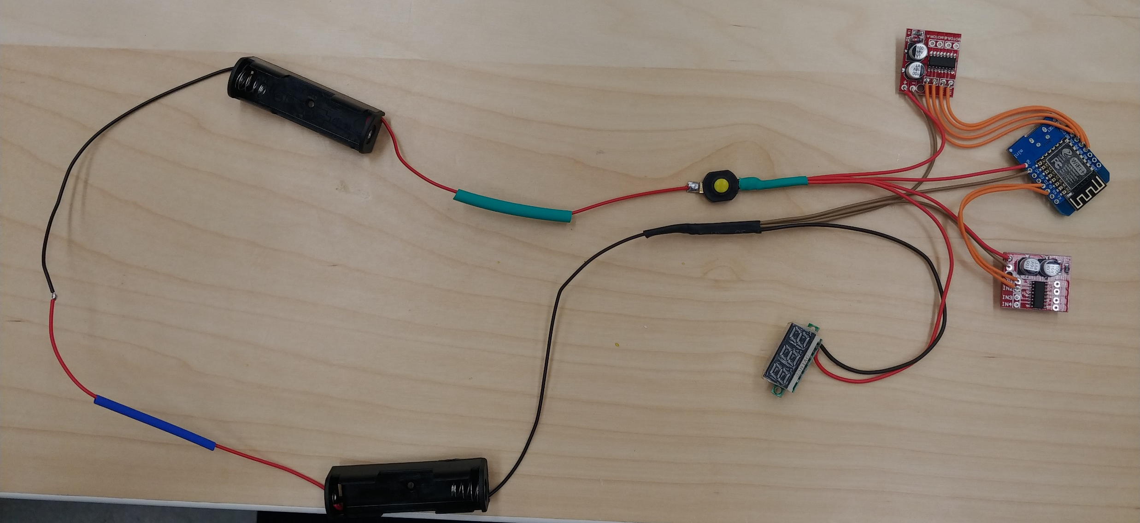
3. Supply wire between Battery and controller
Connect to Battery box

Slide 23
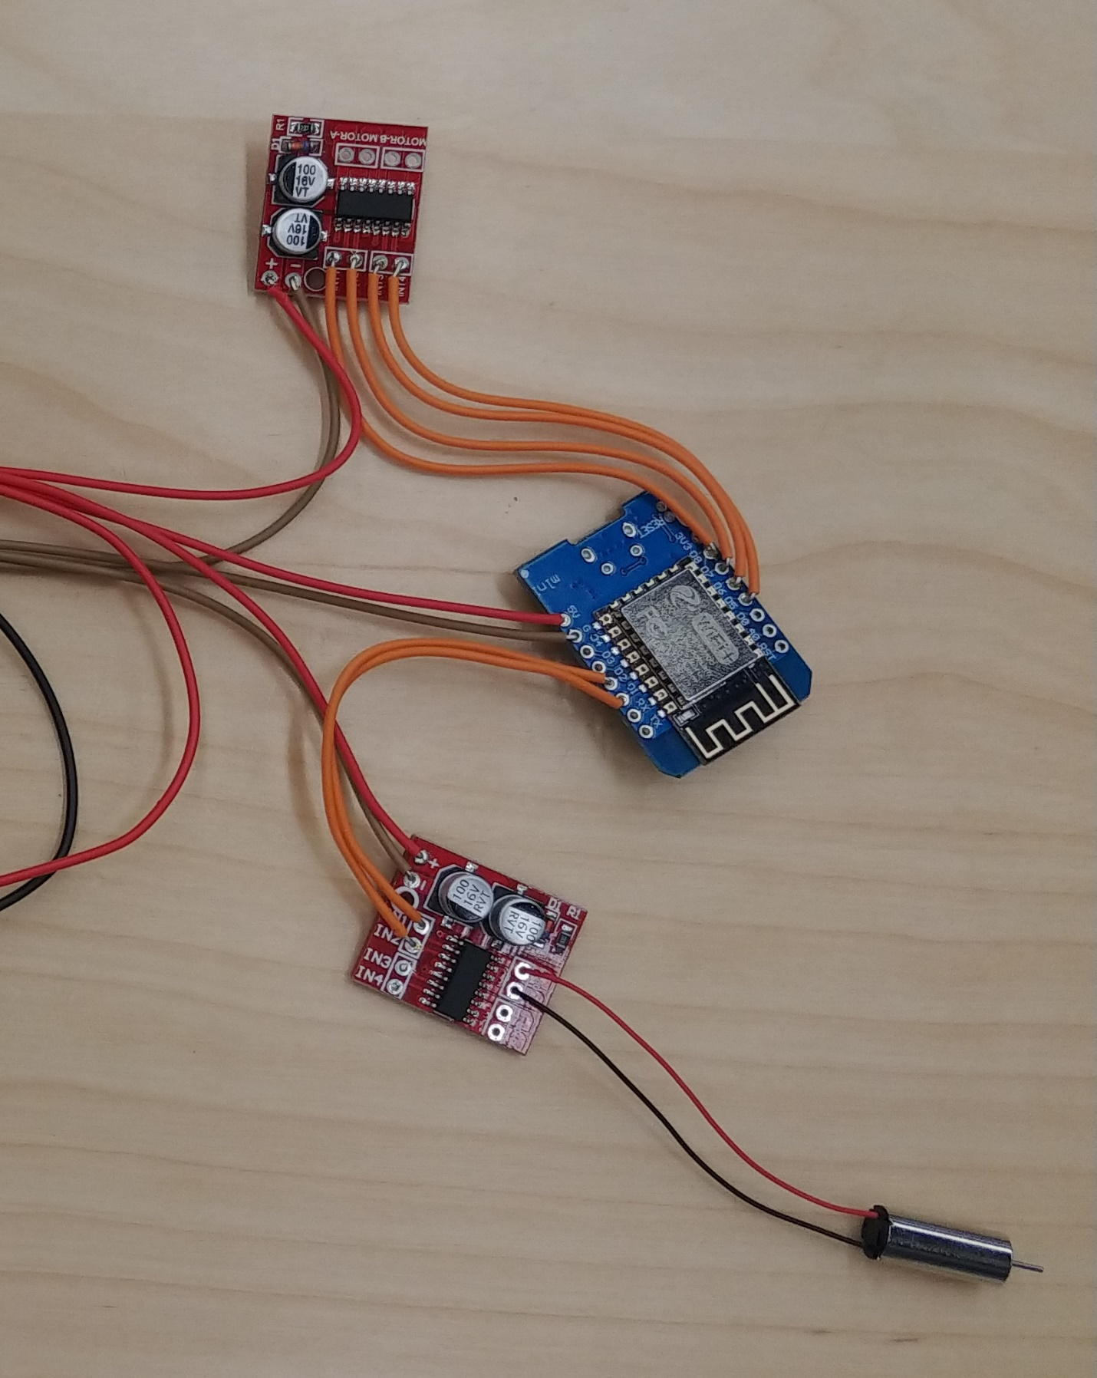
3. Connect to Motors

Slide 24
Checking
Check all the connection (No short circuit with others wires)
Try to connect a USB wire between D1 mini and your laptop computer

Slide 25
Q & A

